Slide 1

BUTTON
MUSIC
Using microcontroller
to
realize the button player
———指尖的音乐
GROUP2 :
YITING ZHOU
WEIRAN ZHANG
XIAOYU XIONG
YUXIN PU

Slide 2
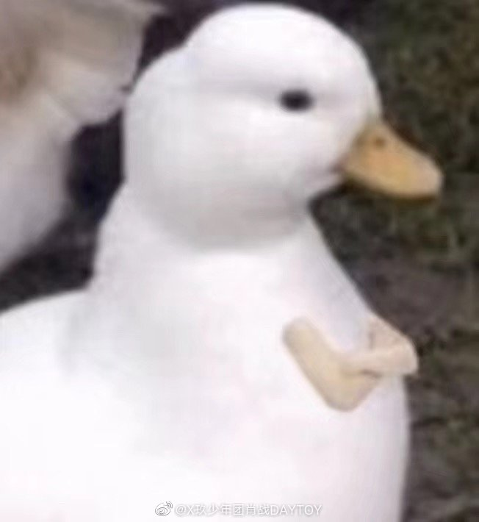
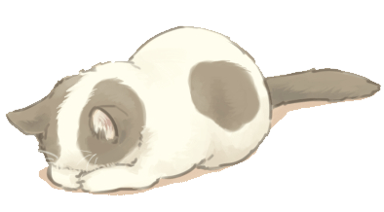
大家早上好，今天我们会向大家展按钮示弹奏器
通过这周的课程，我们学了EIE的液晶显示屏，发光二极管，按钮，蜂鸣器
所以我们制作了一个按钮弹奏器，它包含了我们所学的功能
当LED 亮的时候，我们按下按键就会有音乐响起
Good morning everyone today we are going to show you the BUTTON MUSIC.
Through this week’s course. We learned the EIE of LCD、LED、BUTTON AND BUZZER.
So we make the button music It contains what we’ve learned.
When the LED lights, we press the button it will make a sound
..
。

Slide 3
目
01
OUR IDEA
CONTENTS
我们的想法
录
02
OUR PROGRAM
我们的功能
03
DEMONSTRATE
互动演示

Slide 4

THE FIRST PART
OUR IDEA
BUTTON（YITING ZHOU）
LED
(WEIRAN ZHANG)
Make the buzzer sound according to
the light pressing the button
BUTTON
Play according to the change of the light
根据灯按下按钮使
蜂鸣器发出声音
BUZZER
LCD
LCD
(YUXIN PU)
LED
BUZZER
(XIAOYU XIONG)
Change the scale with frequency.
SHOW THE NAME OF THE SONG
用频率来改变音阶

Slide 5

THE SECOND PART
OUR PROGRAM
Remember the order of lights and press the button to play a song
记住灯亮的顺序然后按下按钮弹奏出一首歌

Slide 6




GAME
TIME
We 'll invite one of our classmates to play this game
Count ducks
数鸭子

Slide 7
THANK YOU FOR WATCHING!
谢谢观看
Click here to enter your text.Click here to enter your text.Click here to enter your text.Click here to enter your text..Click here to enter your text.

